Slide 1
Kompletens för framtiden
Pakiet kompetencji, który gwarantuje Ci udane życie
Call 2019 Round 1 KA2 - Cooperation for innovation and the exchange of good practices
KA229 - School Exchange Partnerships Project numer : 2019-SE01-KA229-060423_4
KNOW YOUR METAPROGRAMS
YOUR STRENGTHS AND WEAKNESSES

Slide 2
METAPROGRAMS
Metaprograms are like software applications for the brain that direct your decisions, behaviors, actions and interactions with others.
They are internal representations of your external experience of reality.

Slide 3
METAPROGRAMS
Metaprograms are processes used to sort what you pay attention to based on the information you filter-out from your environment.

Slide 4
METAPROGRAMS
This filtering process helps guide and direct our thought processes, resulting in significant differences in behavior from person-to-person.

Slide 5
METAPROGRAMS
Metaprograms are never stable and can change over time as you come across new information and expand your knowledge and understanding of your life and circumstances.
Another context or a new situation may create new behaviour.
Metaprograms can for instance change when you’re under heavy stress or experiencing other emotional difficulties. They are therefore never stable, but rather adaptive.

Slide 6
Metaprograms are neither negative nor positive.
The metaprograms you use to perceive and interact with your world either work for you or they work against you.
If you want them to work for you you have to think about your personal goals and objectives.

Slide 7
TASK 1 - KNOW YOUR METAPROGRAMS

Slide 16
TASK 2- SHARE YOUR KNOWLEDGE
Tell your teammates how you graded yourself in each point
( from 1 to 8).
Provide real life examples.
How different you are from each other?
How similar are you to each other?
Does your behaviour change in a new situation?

Slide 17
TASK 2- SHARE YOUR KNOWLEDGE

Slide 18
FINAL REFLECTIONS
My individual potential…
How different you are from each other?
How similar are you to each other?
Does your behaviour change in a new situation for you?

Slide 19
YOUR STRENGTHS AND WEAKNESSES

Slide 20
THE BIG FIVE PERSONALITY TRAITS

Slide 21
ARE THE BIG FIVE TRAITS UNIVERSAL?
Psychologists (McCrae and his colleagues) have found that the big five traits are remarkably universal.
One study that looked at people from more than 50 different cultures found that the 5 dimensions could be accurately used to describe personality.
However, we should remember that behavior involves an interaction between a person's underlying personality and situational variables.

Slide 22
OPENNESS
People who are high in this trait tend to be more adventurous and creative. People low in this trait are often much more traditional and may struggle with abstract thinking.
High | Low
very creative open to trying new things focused on tackling new challenges happy to think about abstract concepts | dislikes change does not enjoy new things resists new ideas not very imaginative dislikes abstract or theoretical concepts

Slide 23
CONSCIENTIOUSNESS
Standard features of this dimension include high levels of thoughtfulness, good impulse control, and goal-directed behaviors.﻿ Highly conscientious people tend to be organized and mindful of details. They plan ahead, think about how their behavior affects others, and are mindful of deadline
High | Low
spends time preparing finishes important tasks right away pays attention to details enjoys having a set schedule | dislikes structure and schedules makes messes and does not take care of things fails to return things or put them back where they belong fails to complete necessary or assigned tasks

Slide 24
EXTRAVERSION
Extraversion (or extroversion) is characterized by sociability, talkativeness, assertiveness, and high amounts of emotional expressiveness.
People who are high in extraversion are outgoing and tend to gain energy in social situations. People who are low in extraversion (or introverted) tend to be more reserved and have less energy to expend in social settings.
High | Low
likes to start conversations enjoys meeting new people has a wide social circle of friends and acquaintances finds it easy to make new friends feels energized when around other people | prefers solitude feels exhausted when having to socialize a lot finds it difficult to start conversations dislikes making small talk dislikes being the center of attention

Slide 25
AGREEABLENESS
This personality dimension includes attributes such as trust, altruism, kindness, affection, and other prosocial behaviors.
High | Low
has a great deal of interest in other people cares about others feels empathy and concern for other people assists others who are in need of help | takes little interest in others does not care about how other people feel has little interest in other people's problems manipulates others to get what they want

Slide 26
NEUROTISM
Neuroticism is a trait characterized by sadness, moodiness, and emotional instability.
High | Low
experiences a lot of stress worries about many different things gets upset easily experiences dramatic shifts in mood feels anxious | emotionally stable deals well with stress rarely feels sad or depressed does not worry much is very relaxed

Slide 27
TASK 3- DO YOUR PERSONALITY TEST!
https://www.123test.com/personality-test/

Slide 28
YOUR TESTS AND YOUR OPINIONS
1.Do you agree with the results of the report? Raise ‘you hand’ if you agree. Explain why? Why not?
2. How can the textual summary of your report help you understand your own behaviour?
3. How can this report help you understand other people?
Chat

Slide 29
TASK 4- TEAM WORK
Imagine you have been asked to choose 1 partner for your new project. Pay attention of the fact that you are not an expert in this field.
What should your project partner be like?
Choose 5-10 features ( 1 or 2 from each category : openness to experience, conscientiousness, extraversion, agreeableness, natural reactions?. Explain your choices.
Your project is about :
classroom 1- nuclear power
classroom 2- gardening
classroom 3- microbiology
classroom 4- future professions
classroom 5- ICT programming
classroom 6- ART performances

Slide 30
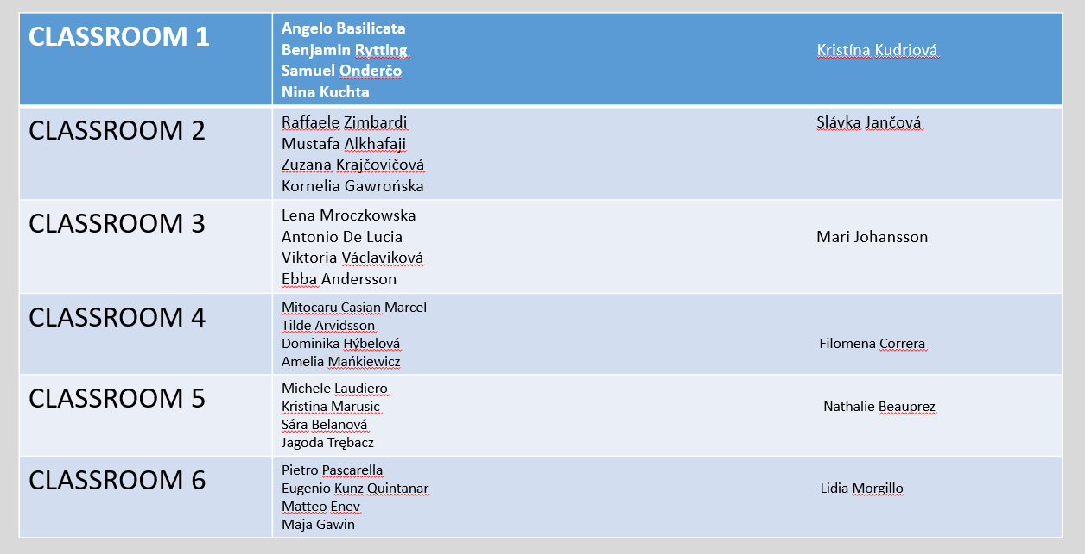

Slide 31
Let’s summarize the workshop
Which sentence present the best summary of the workshop?
1. It is important to know our features only for ourselves.
2. If I am aware of the diversity of human features, I can build an effective team.
3. If I am aware of the diversity of human characteristics, I can build an effective team and work in various areas.

Slide 33
NETOGRAPHY
https://blog.iqmatrix.com/meta-programs
https://www.123test.com/personality-test/
http://abk.umed.pl/mocne-strony-a-rynek-pracy/
BIBLIOGRAFY
Revell Jane and Norman Susan, Hanging Over, NLP_- based activities for language learning, Suffire Press ,(1999: 65)

